Slide 1

Comparative Study of Breast Cancer Diagnosis and Prognosis using Machine Learning Techniques

Slide 2
Problem Statement
Deadly Disease: Breast cancer is the second leading cause of cancer death in women. The chance that a woman will die from breast cancer is about 1 in 38 (about 2.6%).
Recurrence: Every woman who has had breast cancer wonders if it will come back. For some women it does, and for others it doesn’t but most recurrences happen in the first 5 years after breast cancer treatment.
Financial Burden: Patients require frequent diagnosis, but today cancer diagnosis is expensive and time consuming.
Scarcity: Also, there is a lack of qualified doctors and clinical centers in small towns and rural areas.

Slide 3
Early diagnosis and prognosis of cancer are imperative for successful treatment.
However, the expenses incurred for diagnosis are high also early accessibility to doctors and medical facilities is difficult especially for rural residents.
This causes rural patients to travel to urban locations for better facilities which adds to the cost of treatment.
With the purpose of making Breast Cancer Diagnosis and Prognosis feasible, accessible, accurate and quick; we have implemented statistical approach and machine learning techniques on the dataset.
Motivation

Slide 4
To use the extracted dataset of cell nuclei features from Fine Needle Aspiration of suspicious breast tissue specimen to train, test and optimise machine learning algorithms, through supervised learning approach.
To perform a comparative study to evaluate the success rate and viability of the trained machine learning classifiers through parameters derived from the resultant confusion matrix, when tested on test dataset.
To develop and deploy a Web based API, using the most effective algorithm for clinical diagnostic practise.
Project Objectives

Slide 5
In this Project we are using 2 different datasets from UCI Dataset Repository :
Breast Cancer Wisconsin (Diagnostic) Dataset:
569*32, where 569 is the data length and 32 is the number of attributes.
Breast Cancer Wisconsin (Prognostic) Dataset:
198*34, where 198 is the data length and 34 being the number of attributes.
The features of the datasets are computed from a digitized image of a fine needle aspirate (FNA) of a breast mass. They describe characteristics of the cell nuclei present in the image.
Literature Survey

Slide 6
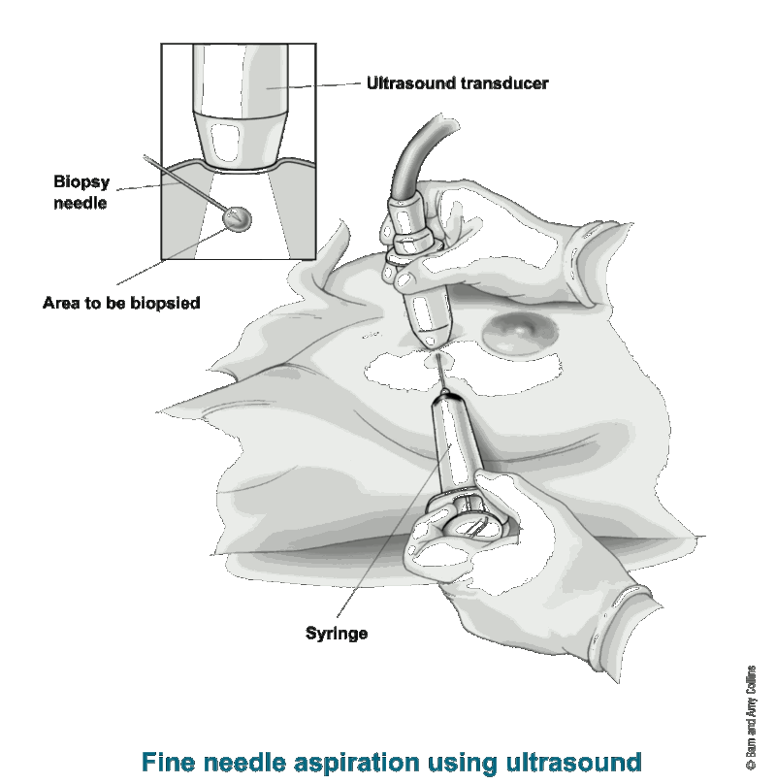
Fine Needle Aspiration(FNA) of Breast Mass

Slide 7
ID number
Diagnosis (M = malignant, B = benign), Prognosis (R = recurring, N = non-recurring)
Ten real-valued features are computed for each cell nucleus:
radius (mean of distances from center to points on the perimeter)
texture (standard deviation of gray-scale values)
Perimeter
Area
smoothness (local variation in radius lengths)
compactness (perimeter² / area )
concavity (severity of concave portions of the contour)
concave points (number of concave portions of the contour)
symmetry
fractal dimension
The mean, standard error, and worst or largest (mean of the three largest values) of these features were computed for each image, resulting in 30 features.
Datasets attribute information

Slide 8
Methodology
Data Cleaning
Visualization & Exploration
Data Preprocessing
Modeling
Optimization
Comparison
Web-API deployment

Slide 9
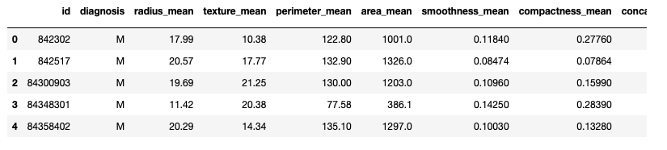
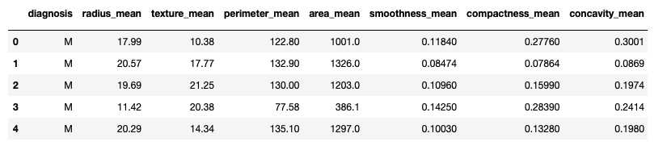
Data Cleaning
Removing Null values and dropping irrelevant attributes from the dataset as shown below:

Slide 10
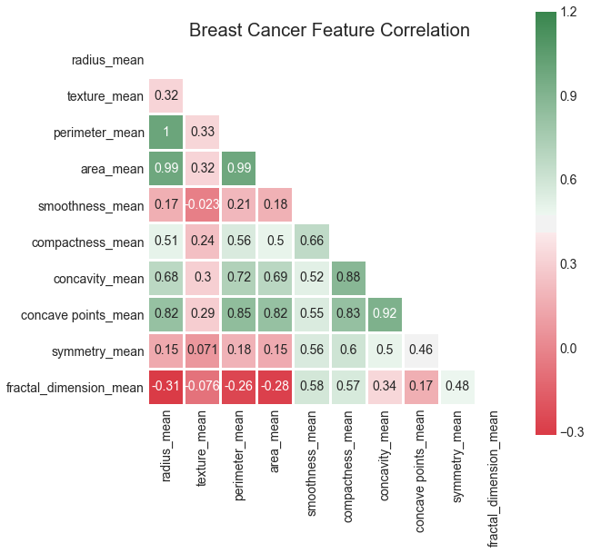
Visualization & Exploration
Correlation heat map is used to know the correlation between the attributes of the dataset and to analyze coherence.
This plot is mainly used to judge data quality.

Slide 11
In this step we use standard scaler to standardize the attributes.
This transforms data to gaussian distribution with unit variance and zero mean.
We have also created the train/test data split in this step.
We also transformed objects ‘M’ and ‘B’ into integers ‘1’ and ‘0’ respectively.
Data Preprocessing

Slide 12
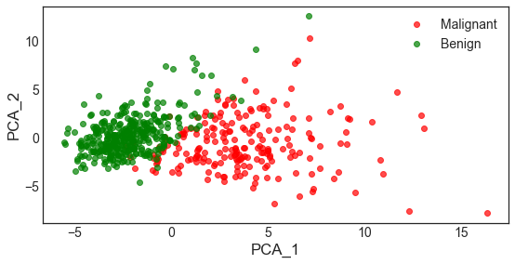
Data Feature Extraction
For Feature Extraction of data we have used Principal Component Analysis(PCA) which orthogonally transforms data into a lower dimension with a constraint of highest variance.
It can be inferred from the plot that first two principal components exhibit high variance for ‘Benign’ and “Malignant’ classes.

Slide 13
The output from train/test splits is used to obtain confusion matrix, which includes the True Positive Value (TPV), False Positive Value (FPV), True Negative Value (TNV) and False Negative Value (FNV) for each algorithm.
These values will assist us in drawing proper comparison between Machine Learning Algorithms.
Machine Learning algorithms implemented are as follows: SVM, KNN, LR, LDA, DT and GNB.
Modelling

Slide 14
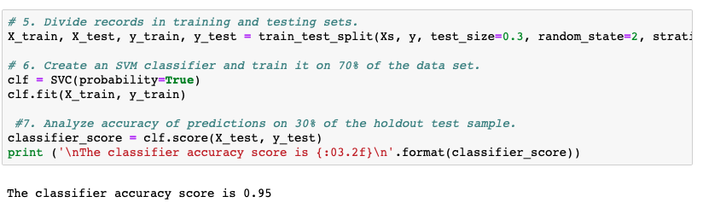
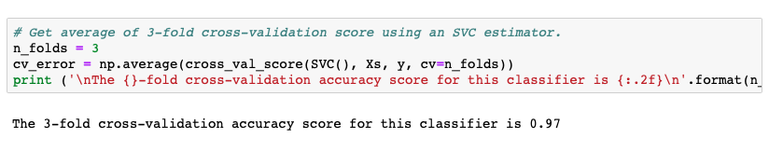
Implementation of SVM

Slide 15
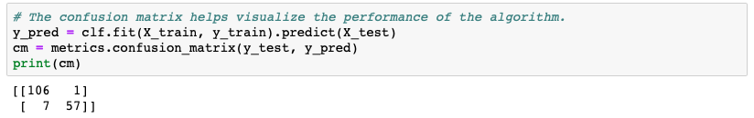
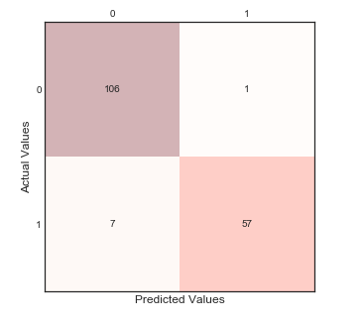
Confusion Matrix

Slide 16
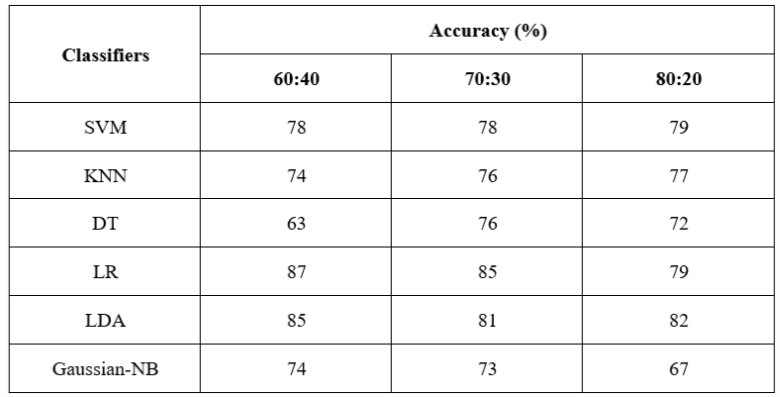
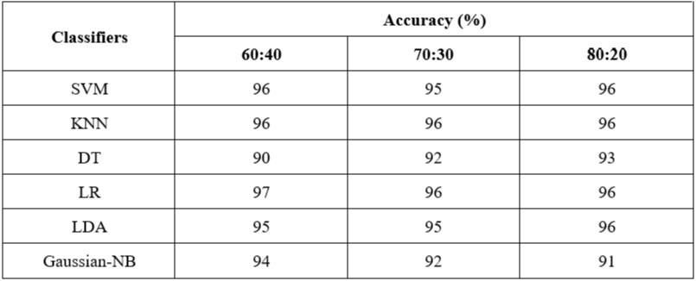
Implementation of MLA

Slide 17
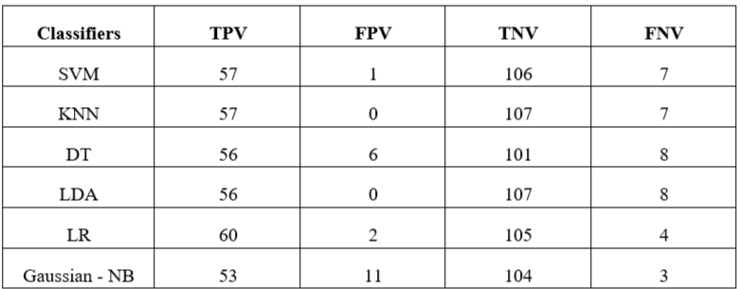
Implementation of MLA for WDBC

Slide 18
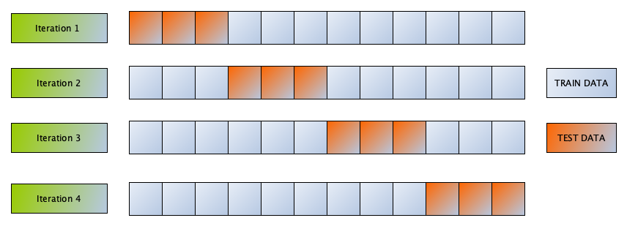
Cross Validation
In cross validation dataset is divided into n-folds, were 1-fold becomes test data and rest (n-1) folds are utilized as train data, this is repeated n times, where the output accuracy is the mean of n accuracies.

Slide 19
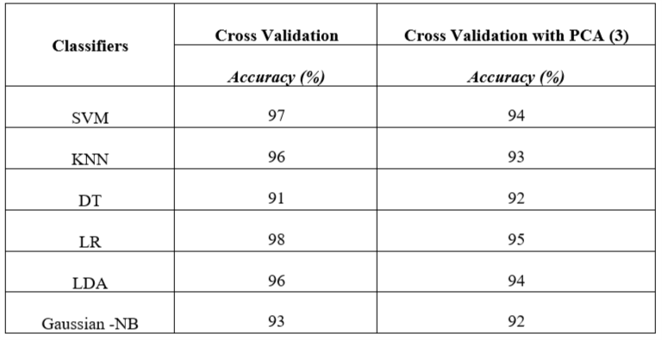
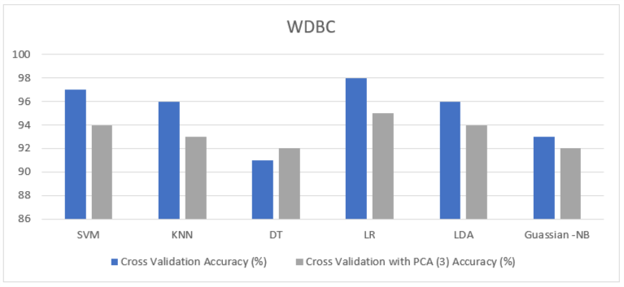
Implementation of Cross Validation on WDBC

Slide 20
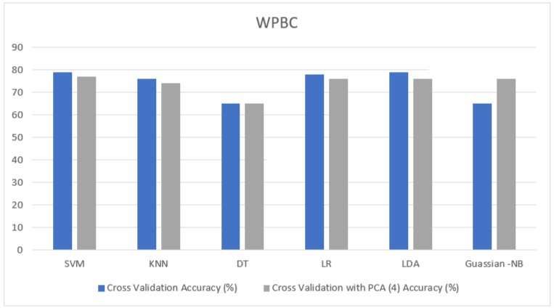
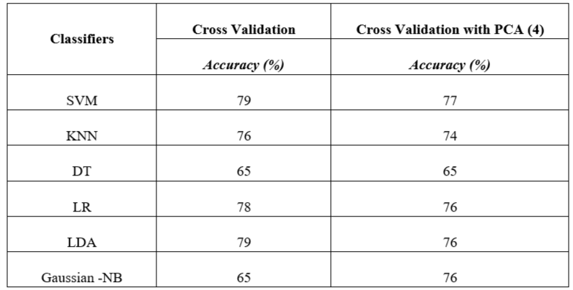
Implementation of Cross Validation on WPBC

Slide 21
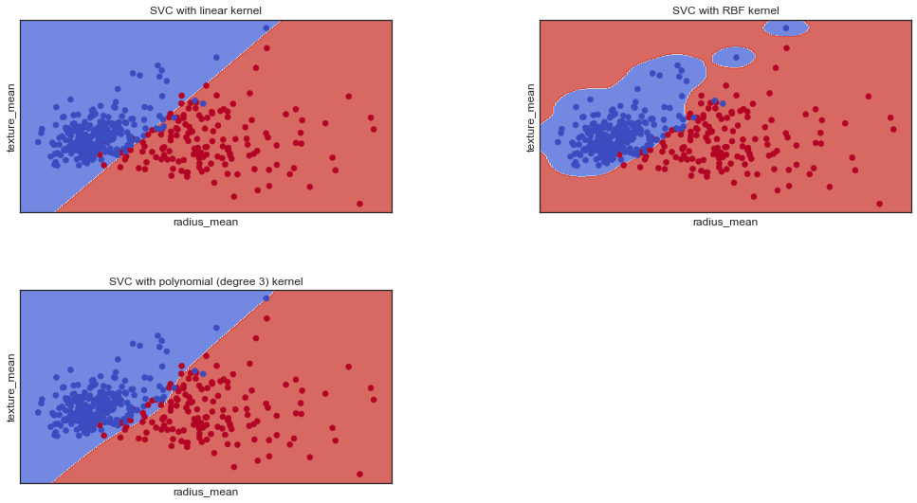
Optimization of SVM using different kernel

Slide 22
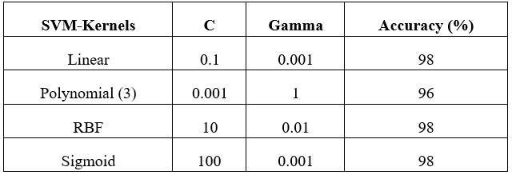
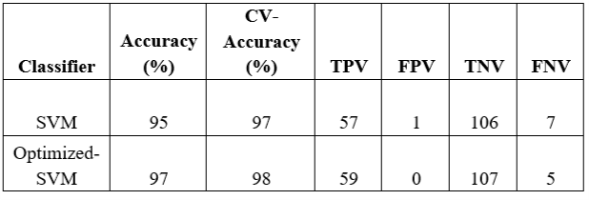
Optimization of SVM

Slide 23
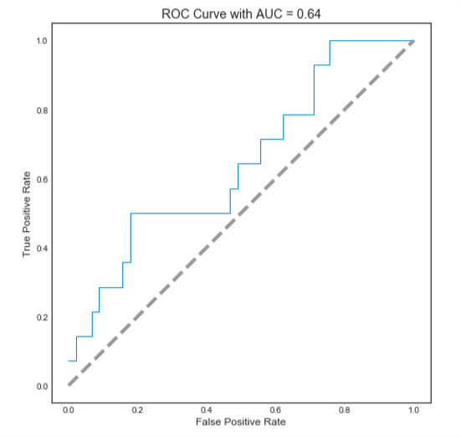
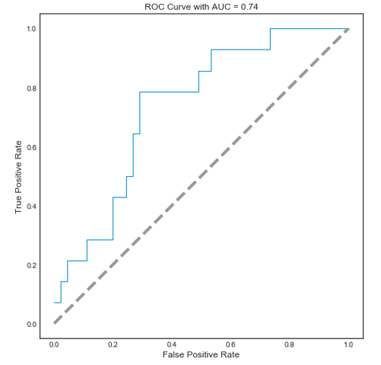
ROC curve optimization
Receiver operating characteristic (ROC) has an ideal Area under the curve (AUC) of 1.
This curve is used to know how well the model has performed.
Here AUC is improved from 0.64 to 0.74, after SVM model optimization.

Slide 24
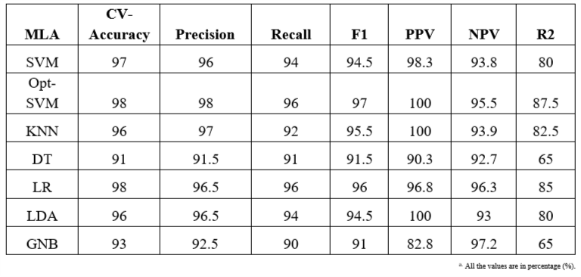
Comparison of MLA for WDBC dataset
From table it can be inferred that optimized SVM algorithm with linear kernel performs best under most of the performance parameters.
Where it has the highest score for all performance parameters except Negative Predictive Value (NPV).
Here LR is the second-best performing classifier.

Slide 25
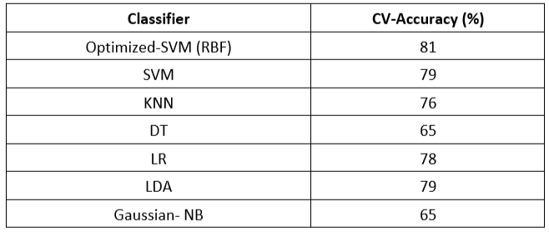
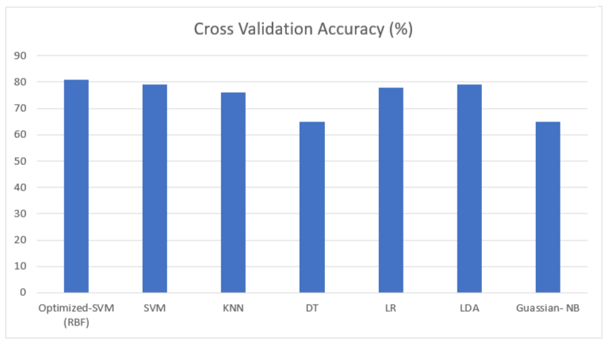
Comparison of MLA for WPBC dataset
From table we can infer that Optimized SVM has maximum accuracy on cross validation.
However, in this case SVM is utilizing RBF kernel with different tuned input parameters.

Slide 26
After drawing the comparison between multiple machine learning algorithms(MLA), we found that optimized SVM algorithm with linear kernel performed best for WDBC dataset whereas, for WPBC dataset we found that optimized SVM algorithm with RBF kernel showed the best result.
Thus we deployed optimized SVM model on the Web API using a Microsoft Azure ML studio.
Deployment of Web-API

Slide 27
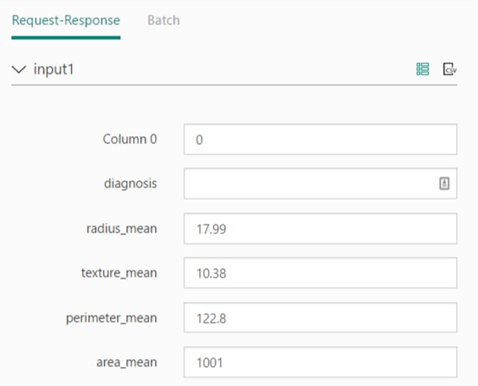

Web-API UI

Slide 28
Conclusion
In this experiment, we performed a comparative analysis between multiple machine learning algorithms, on WDBC and WPBC datasets.
For the WDBC dataset, we found optimized SVM with linear kernel to be best performing algorithm on most parameters. Similarly, for the WPBC dataset, we found optimized SVM with Radial Basis function kernel to be most accurate.
Our experimental results were comparable or better with related works, this was possible with optimization of SVM which gave an accuracy of 98% and 81% for WDBC and WPBC dataset, respectively.
Finally, we deployed this algorithm on Web based API, which would assist clinicians in performing diagnostic and prognostic classification in least time.

Slide 29

In this destructive world,
CREATE SOMETHING
Thank You

